Slide 1
Lines of Code and Functional Points

Slide 2
LOC and FP data are used in two ways
during software project estimation: (1) as estimation variables to “size” each element
of the software and (2) as baseline metrics collected from past projects and used in
conjunction with estimation variables to develop cost and effort projections.

Slide 3
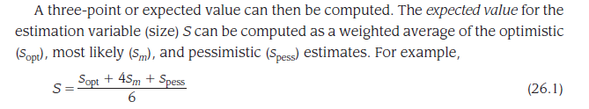
Once the expected value for the estimation variable has been determined, historical LOC or FP productivity data are applied.

Slide 4
Example of LOC
The mechanical CAD software will accept two- and three-dimensional geometric data from an engineer. The engineer will interact and control the CAD system through a user interface that will exhibit characteristics of good human/machine interface design. All geometric data and other supporting information will be maintained in a CAD database.
Design analysis modules will be developed to produce the required output, which will be displayed on a variety of graphics devices. The software will be designed to control and interact with peripheral devices that include a mouse, digitizer, laser printer, and plotter.

Slide 5
A range of LOC estimates is developed for each function. For example, the range of LOC estimates for the 3D geometric analysis function is optimistic, 4600 LOC; most likely, 6900 LOC; and pessimistic, 8600 LOC. Applying Equation 26.1, the expected value for the 3D geometric analysis function is 6800 LOC.

Slide 6
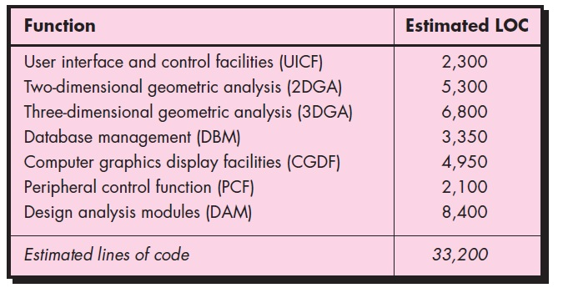
A review of historical data indicates that the organizational average productivity for systems of this type is 620 LOC/pm. Based on a burdened labor rate of $8000 per month, the cost per line of code is approximately $13. Based on the LOC estimate and the historical productivity data, the total estimated project cost is $431,000 (or 432,000 by rounding up) and the estimated effort is 54 person-months

Slide 7
The function point metric (FP),first proposed by Albrecht [ALB79], can be used effectively as a means for measuring the functionality delivered by a system.
Function points are derived using an empirical relationship based on countable (direct) measures of software's information domain and assessments of software complexity assessments of software complexity
Information domain values are defined in the following manner:
Number of external inputs (EIs)
Number of external outputs (EOs)
Number of external inquiries (EIs)
Number of internal logical files (ILFs)
Number of external interface files (EIFs)

Slide 8
Each external input originates from a user or is transmitted from another application and provides distinct application-oriented data or control information. Inputs are often used to update internal logical files (ILFs). (E.g. Writes, deletes, updates)
Each external output is derived data within the application that provides information to the user. In this context external output refers to reports, screens, error messages, etc. It is created by the application, hence derived.

Slide 9
An external inquiry is defined as an online input that results in the generation of some immediate software response in the form of an online output.
Each internal logical file is a logical grouping of data that resides within the application’s boundary and is maintained via external inputs.
is internally maintained,
it has some logical structure and
it is stored in a file.

Slide 10
Each external interface file is a logical grouping of data that resides external to the application but provides information that may be of use to the application.

Slide 11
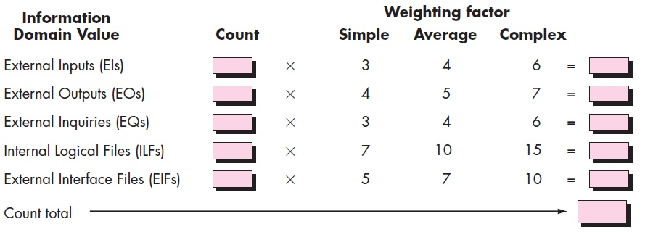

Slide 12
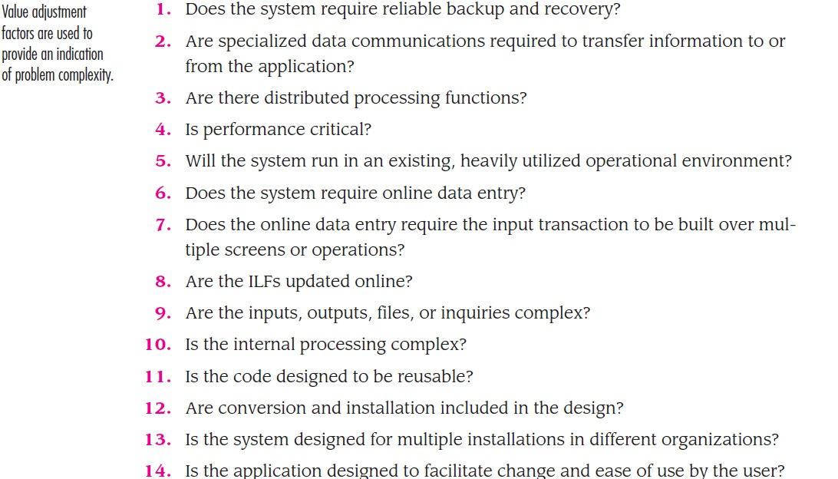
0 (not important or applicable) to 5 (absolutely essential)

Slide 13
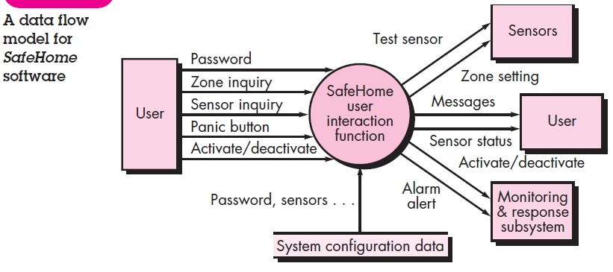
The data flow diagram is evaluated to determine a set of key information domain measures required for computation of the function point metric.
Three external inputs—password, panic button, and activate/deactivate.
Two external inquiries—zone inquiry and sensor inquiry.
One ILF (system configuration file)
Two external outputs (messages and sensor status)
Four EIFs (test sensor, zone setting, activate/deactivate, and alarm alert)

Slide 14
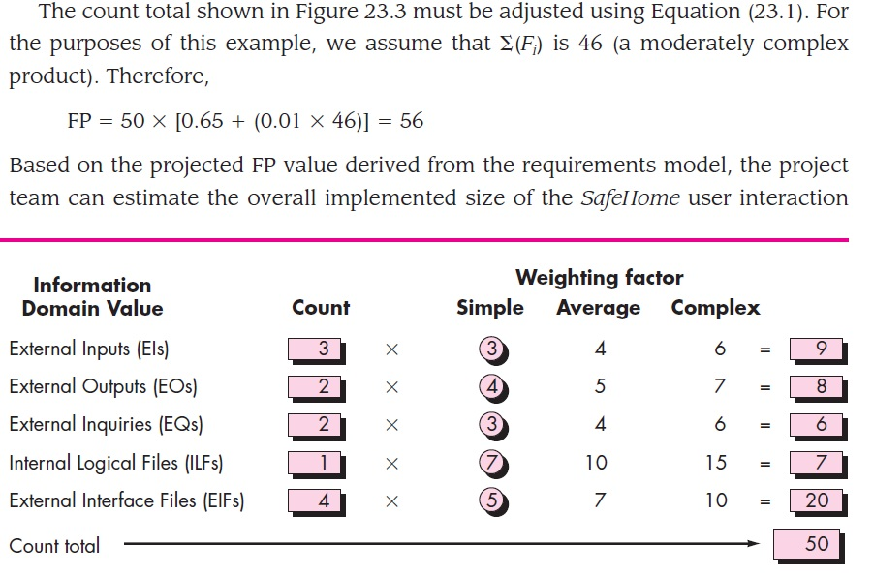

Slide 15
Assume that past data indicates that one FP translates into 60 lines of code (an object-oriented language is to be used) and that 12 FPs are produced for each person-month of effort. These historical data provide the project manager with important planning information that is based on the requirements model rather than preliminary estimates. Assume further that past projects have found an average of three errors per function point during requirements and design reviews and four errors per function point during unit and integration testing. These data can ultimately help you assess the completeness of your review and testing activities.

Slide 16
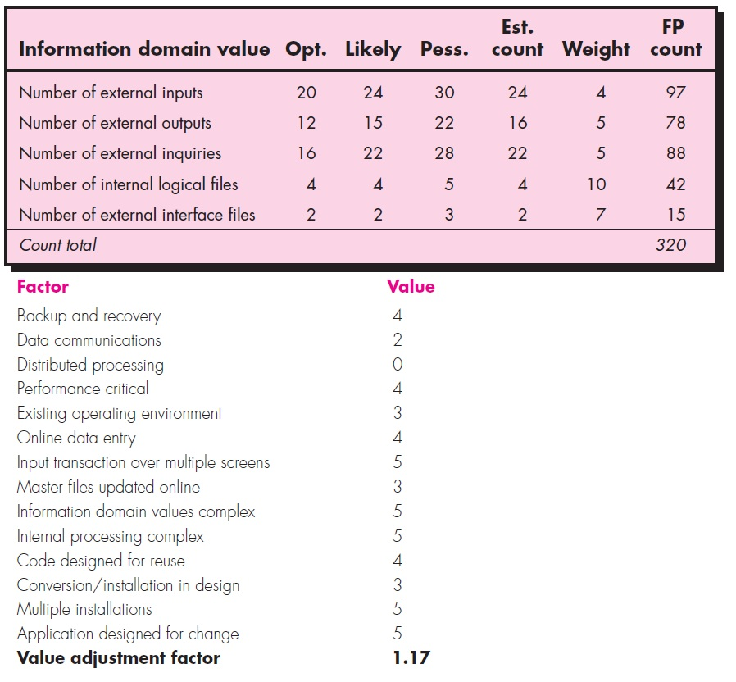
FP = 375
The organizational average productivity for systems of this type is 6.5 FP/pm. Based on a burdened labor rate of $8000 per month, the cost per FP is approximately $1230.
Based on the FP estimate and the historical productivity data, the total estimated project cost is $461,000 and the estimated effort is 58 person-months.

